Slide 1


Initializing TIPSY 4.3 with Silviculture Survey (RESULTS) Data
FY2012-13
Consultants’ Report by:
Steve Stearns-Smith, RPF and Wendy Bergerud
Project Debriefing Meeting
03 April 2013

Slide 2
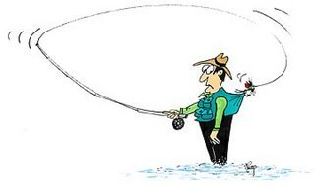
Backcasting,
the opposite of forecasting.

Slide 3
Project Intent
Initializing TIPSY with SilvSurvey Data
A first approximation of standard operating procedures.
Primary emphasis on initial density and spatial distribution, building on Wendy’s analyses.
Other aspects secondary (OAFs, etc)
i.e., conceptual, no supporting analysis.
General procedures to support TSR, SDM, FFT, etc.

Slide 4
Reflects SilvSurvey Limitations
Initializing TIPSY with SilvSurvey Data
Not designed to support TIPSY (free-growing declaration, not GY)
Broader range of stand conditions than TIPSY (therefore, follow historic practice standards for other TIPSY apps)
Survey Standards may sound supportive, but always check field practices (e.g., NP)
Potential for ocular surveys (no plot data)

Slide 5
Reflects TIPSY Limitations
Initializing TIPSY with SilvSurvey Data
Long list in report, key limitations include:
  bare ground (why backcasting is required)
  single-species, even-age
  does not predict ingress or natural disturbance events
  regen method implications
  mixed-species implications
  OAF implications
Backcasting even more limited in some areas

Slide 6
Regen Method (P,N,C) Implications
Initializing TIPSY with SilvSurvey Data
Independent from regen delay
Defines fixed seedling establishment period (EP)
Planted = 1yr
Natural & Clumped =~10yrs
Defines fixed spatial distribution (SD)
Planted = square spacing
Natural = random
Clumped = clumped random (one clumpiness)
Regen method, EP & SD are not independent in TIPSY
Genetic gain only applied to Planted

Slide 7
Planted
Regen Delay = 1yr (default = 0)
(no accommodation for natural ingress)
Natural (or Clumped)
Regen Delay = 2yr (default = 2)
(additional 1yr germination lag plus ~10yr establishment period are fixed)
Stand Disturbance
0
1
2
3
4
5
6
7
8
9
TIPSY-age
Note how Natural and Clumped make poor surrogates for Planted plus ingress:
Wrong temporal distribution
No genetic gain

Slide 8
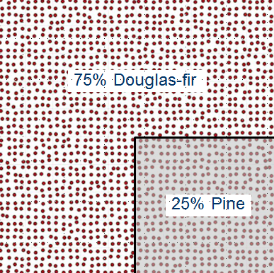
TIPSY Mixed-Species Implications
Initializing TIPSY with SilvSurvey Data
1 ha: 75% Fd + 25% Pl
Same regen method & spatial distribution
Same initial density
Different site indexes
Different mortality rates**
Backcasting methods not established yet.

Slide 9
OAF Implications
Initializing TIPSY with SilvSurvey Data
OAF effect | Losses included in survey densities?
OAF1a – NP | No, unmapped NP not sampled (plots dropped).
OAF1b – non-comm veg | Yes, once it is established.
OAF1c – endemic FH | Some, only those already expressed.
OAF1d – misc events | Some to none, random by nature.
OAF2 – DWB (TSR use) | No. Also consider the alternate TIPSY DWB OAF option.
OAF2 -- alt. FH use | Some, see OAF1c. (just different pattern)
Ideally, add back the included losses before backcasting. Then (re)apply full values to forecast.

Slide 10
Opportunities to Modify TIPSY’s Existing Stand Routine
Initializing TIPSY with SilvSurvey Data
Already incorporates:
  Single-species, site index, regen delay, OAFs, PCT
  Initial density backcasting (<10K sph), given regen method (spatial dist)
Backcasting by interpolation, no functions to refit.
Additional potential:
  Batch TIPSY implementation
  Regen method (spatial dist) backcasting
  Partial OAFs in backcasting
  Maybe: mixed-species, genetics, etc.

Slide 11
Questions?

